Slide 1

Lecture 1. Introduction
(Asymptotic Notation, Algorithm Analysis)
Speaker
...

Slide 2
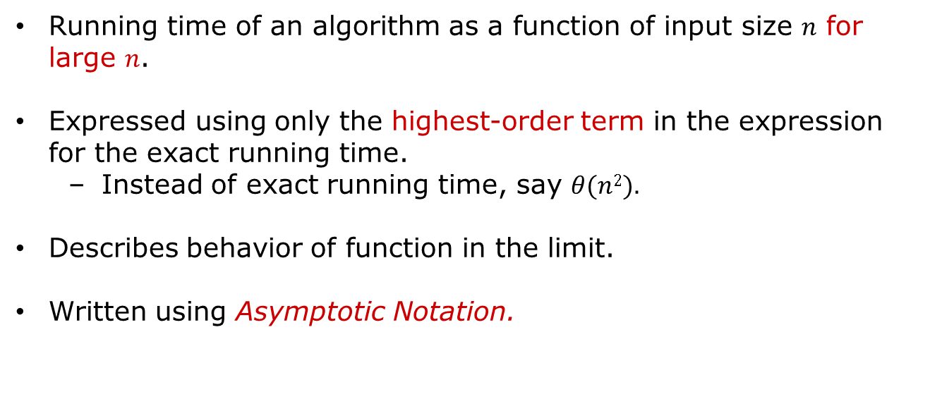
Lecture 1. Introduction (Asymptotic Notation, Algorithm Analysis)
Asymptotic Complexity
Running time of an algorithm as a function of input size $n$ for large $n$.
Expressed using only the highest-order term in the expression for the exact running time.
Instead of exact running time, say $θ(n2).$
Describes behavior of function in the limit.
Written using Asymptotic Notation.

Slide 3
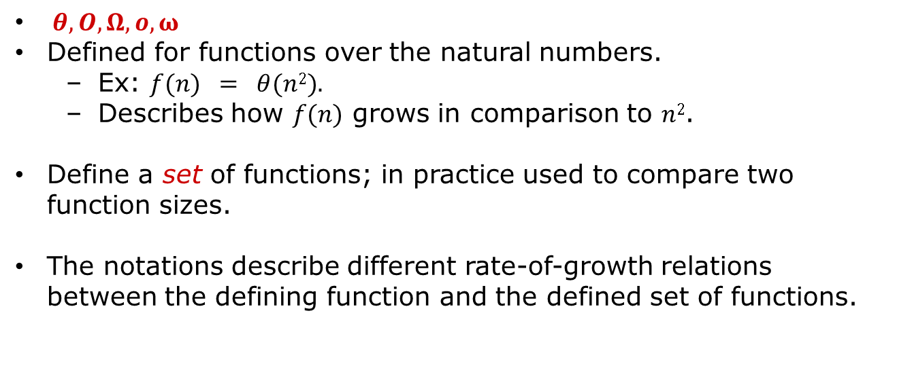
Lecture 1. Introduction (Asymptotic Notation, Algorithm Analysis)
Asymptotic Notation
$θ, O, Ω, o, ω$
Defined for functions over the natural numbers.
Ex: $f(n) = θ(n2).$
Describes how $f(n)$ grows in comparison to $n2$.
Define a set of functions; in practice used to compare two function sizes.
The notations describe different rate-of-growth relations between the defining function and the defined set of functions.

Slide 4





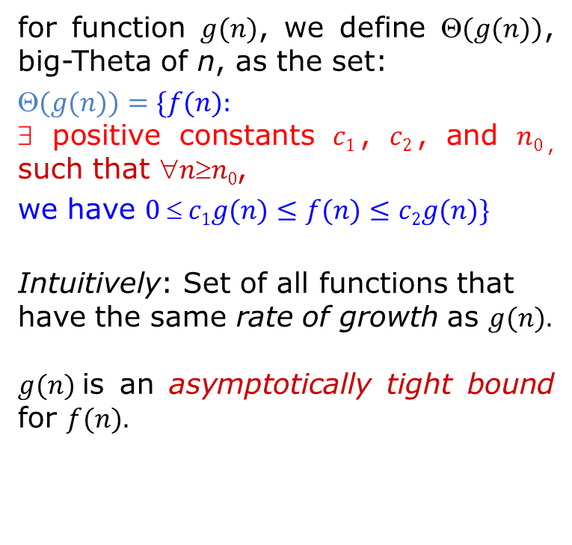

Lecture 1. Introduction (Asymptotic Notation, Algorithm Analysis)
$θ$-notation
for function $g(n)$, we define $(g(n))$, big-Theta of n, as the set:
$$(g(n))=\{f(n):$$ ∃ positive constants $c1$, $c2$, and $n0$, such that $nn0$,
we have $0  c1g(n)≤f(n)≤c2g(n)\}$
Intuitively: Set of all functions that
have the same rate of growth as $g(n).$
$g(n)$is an asymptotically tight bound for $f(n).$
$$c_{2}g(n)$$
$$f(n)$$
$$c_{1}g(n)$$
$$n$$
$$n_{0}$$
$$f\left(n\right)=θ(g\left(n\right))$$

Slide 5
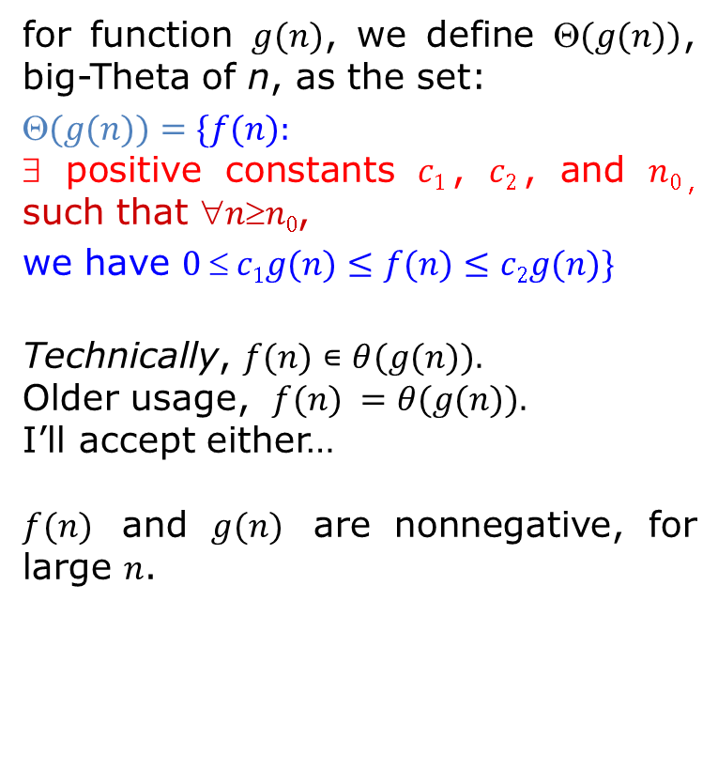
Lecture 1. Introduction (Asymptotic Notation, Algorithm Analysis)
$θ$-notation
for function $g(n)$, we define $(g(n))$, big-Theta of n, as the set:
$$(g(n))=\{f(n):$$ ∃ positive constants $c1$, $c2$, and $n0$, such that $nn0$,
we have $0  c1g(n)≤f(n)≤c2g(n)\}$
Technically, $f(n)∊θ(g(n)).$
Older usage, $f(n) =θ(g(n)).$
I’ll accept either…
$f(n)$ and $g(n)$ are nonnegative, for large $n$.
$$c_{2}g(n)$$
$$f(n)$$
$$c_{1}g(n)$$
$$n$$
$$n_{0}$$
$$f\left(n\right)=θ(g\left(n\right))$$

Slide 6
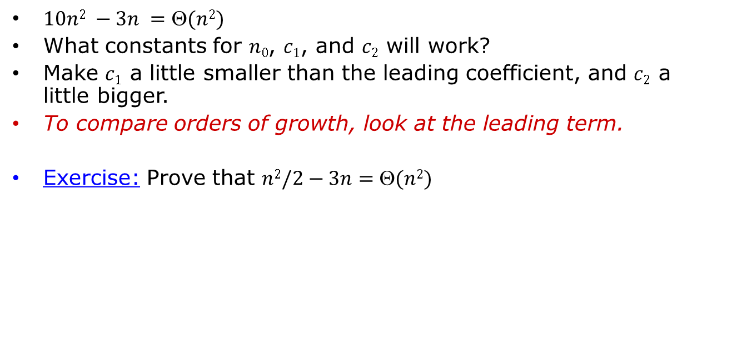
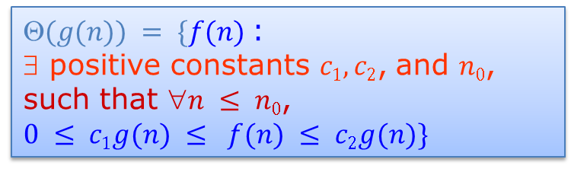
Lecture 1. Introduction (Asymptotic Notation, Algorithm Analysis)
Example
$(g(n)) = \{f(n)$:
∃ positive constants $c1, c2$, and $n0$,
such that $n ≤ n0$,
$$0 ≤ c1g(n) ≤ f(n) ≤ c2g(n)\}$$
$10n2 −3n =(n2)$
What constants for $n0$, $c1$, and $c2$ will work?
Make $c1$ a little smaller than the leading coefficient, and $c2$ a little bigger.
To compare orders of growth, look at the leading term.
Exercise: Prove that $n2/2−3n=(n2)$

Slide 7
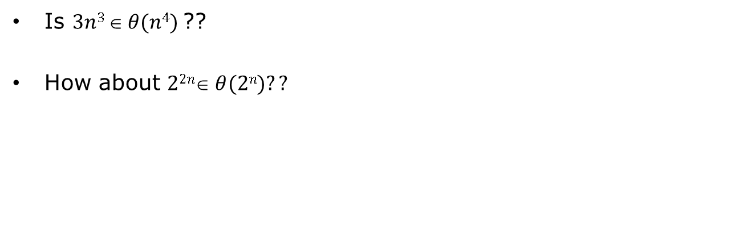
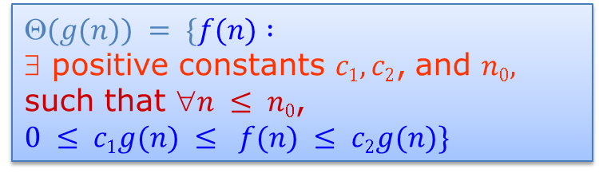
Lecture 1. Introduction (Asymptotic Notation, Algorithm Analysis)
Example
$$(g(n)) = \{f(n) :$$
∃ positive constants $c1, c2$, and $n0,$
such that $n ≤ n0$,
$$0 ≤ c1g(n) ≤ f(n) ≤ c2g(n)\}$$
Is $3n3  θ(n4)$??
How about $22n θ(2n)??$

Slide 8



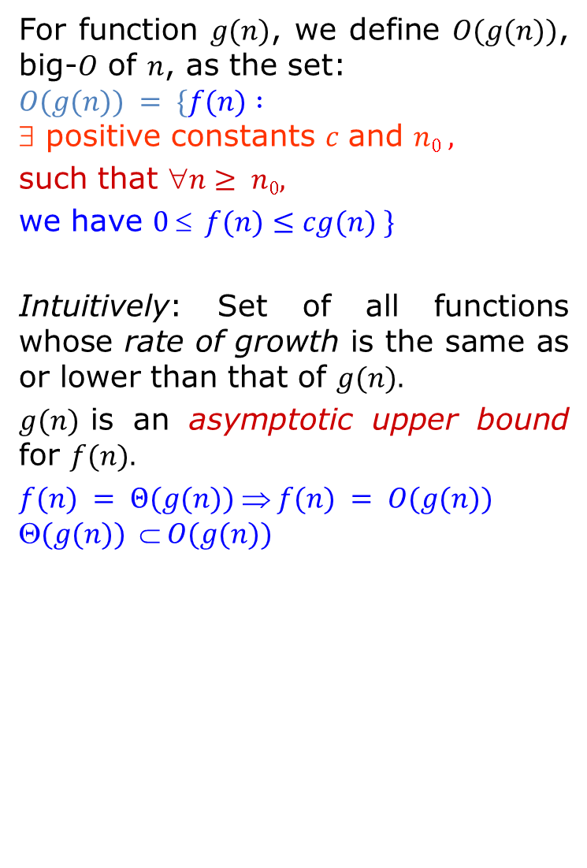


Lecture 1. Introduction (Asymptotic Notation, Algorithm Analysis)
$O$-notation
$$cg(n)$$
For function $g(n)$, we define $O(g(n))$, big-$O$ of $n$, as the set:
$$O(g(n)) = \{f(n) :$$ ∃ positive constants $c$ and $n0 ,$
such that $n≥ n0,$
we have $0  f(n)≤cg(n) \}$
Intuitively: Set of all functions whose rate of growth is the same as or lower than that of $g(n).$
$g(n)$is an asymptotic upper bound for $f(n).$
$$f(n) = Θ(g(n))  f(n) = O(g(n))$$
$$(g(n))  O(g(n))$$
$$f(n)$$
$$n$$
$$n_{0}$$
$$f\left(n\right)=O(g\left(n\right))$$

Slide 9
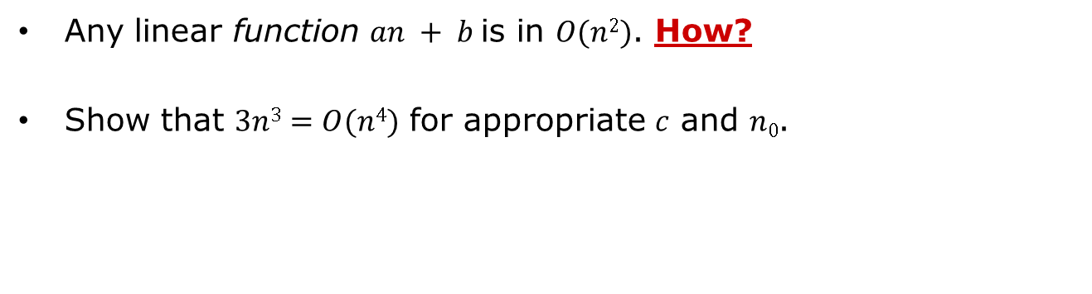
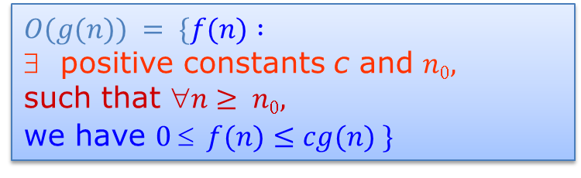
Lecture 1. Introduction (Asymptotic Notation, Algorithm Analysis)
Example
$$O(g(n)) = \{f(n) :$$
positive constants c and $n0,$
such that $n≥ n0,$
we have $0  f(n)≤cg(n) \}$
Any linear function $an + b$is in $O(n2)$. How?
Show that $3n3=O(n4)$ for appropriate $c$ and $n0$.

Slide 10




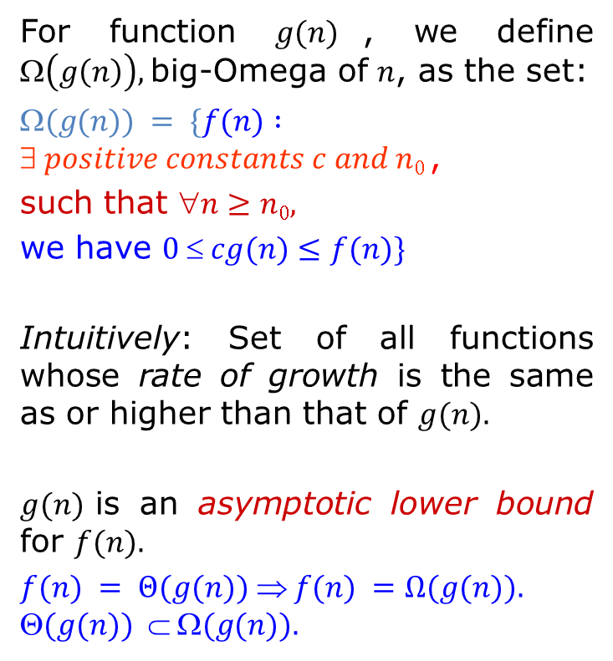

Lecture 1. Introduction (Asymptotic Notation, Algorithm Analysis)
$Ω$-notation
For function $g(n)$, we define $\left(g\left(n\right)\right),$big-Omega of $n$, as the set:
$$(g(n)) = \{f(n) :$$ $ positive constants c and n0$,
such that $n≥n0,$
we have $0  cg(n)≤f(n)\}$
Intuitively: Set of all functions whose rate of growth is the same as or higher than that of $g(n).$
$g(n)$is an asymptotic lower bound for $f(n).$
$$f(n) = Θ(g(n))  f(n) =Ω(g(n)).$$
$$(g(n))  (g(n)).$$
$$f(n)$$
$$cg(n)$$
$$n$$
$$n_{0}$$
$$f\left(n\right)=Ω(g\left(n\right))$$

Slide 11
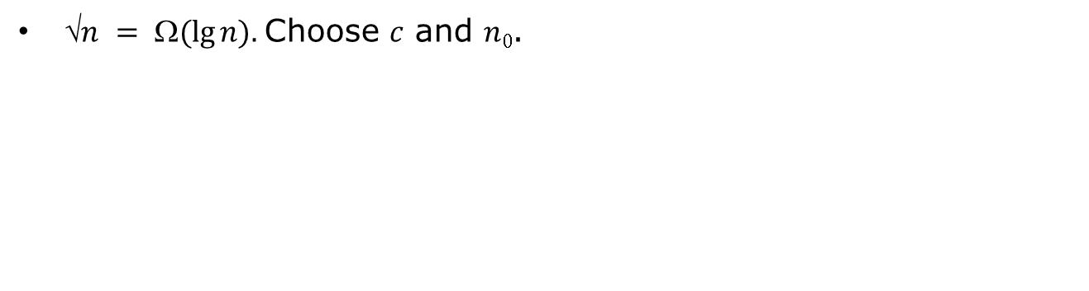
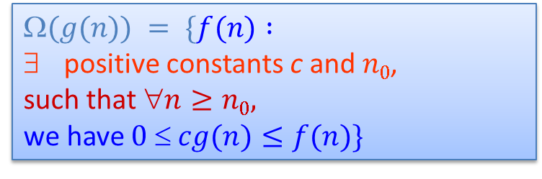
Lecture 1. Introduction (Asymptotic Notation, Algorithm Analysis)
Example
$$(g(n)) = \{f(n) :$$
positive constants c and $n0$,
such that $n≥n0,$
we have $0  cg(n)≤f(n)\}$
$n = (lg⁡n).$Choose $c$ and $n0$.

Slide 12
















Lecture 1. Introduction (Asymptotic Notation, Algorithm Analysis)
Relations Between Θ, O, Ω
$$cg(n)$$
$$c_{2}g(n)$$
$$f(n)$$
$$f(n)$$
$$f(n)$$
$$cg(n)$$
$$c_{1}g(n)$$
$$n_{0}$$
$$n$$
$$n_{0}$$
$$n$$
$$n$$
$$n_{0}$$
$$f\left(n\right)=θ(g\left(n\right))$$
$$f\left(n\right)=O(g\left(n\right))$$
$$f\left(n\right)=Ω(g\left(n\right))$$

Slide 13
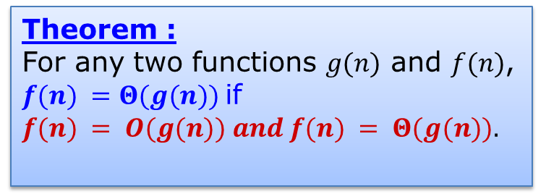
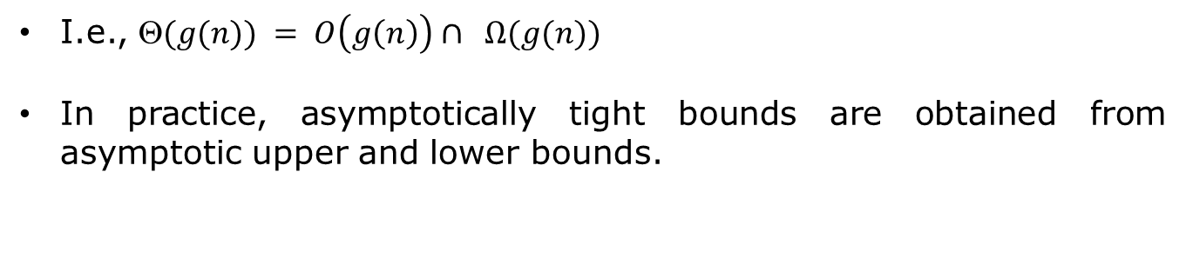
Lecture 1. Introduction (Asymptotic Notation, Algorithm Analysis)
Relations Between Θ, O, Ω
Theorem :
For any two functions $g(n)$ and $f(n)$, $f(n) =Θ(g(n))$if
$$f(n) = O(g(n)) and f(n) = Θ(g(n)).$$
I.e., $(g(n)) = O\left(g\left(n\right)\right)∩ Ω(g(n))$
In practice, asymptotically tight bounds are obtained from asymptotic upper and lower bounds.

Slide 14
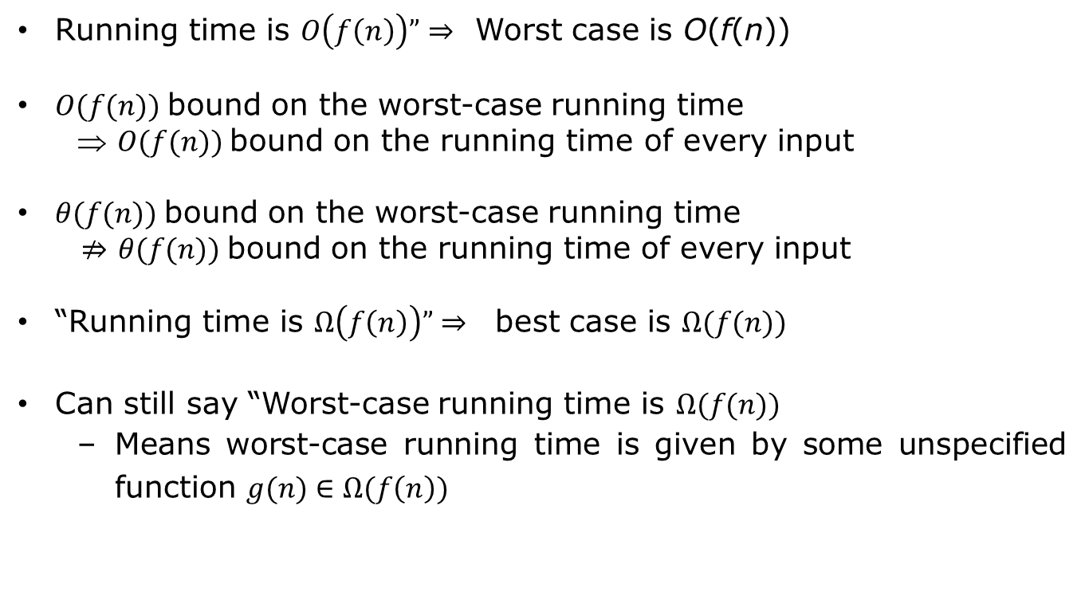
Lecture 1. Introduction (Asymptotic Notation, Algorithm Analysis)
Running Times
Running time is $O\left(f\left(n\right)\right)”⇒$ Worst case is O(f(n))
$O(f(n))$bound on the worst-case running time
⇒ $O(f(n))$bound on the running time of every input
$θ(f(n))$bound on the worst-case running time
$⇏$ $θ(f(n))$bound on the running time of every input
“Running time is $Ω\left(f\left(n\right)\right)”⇒$ best case is $Ω(f(n))$
Can still say “Worst-case running time is $Ω(f(n))$
Means worst-case running time is given by some unspecified function $g(n)∈Ω(f\left(n\right))$

Slide 15
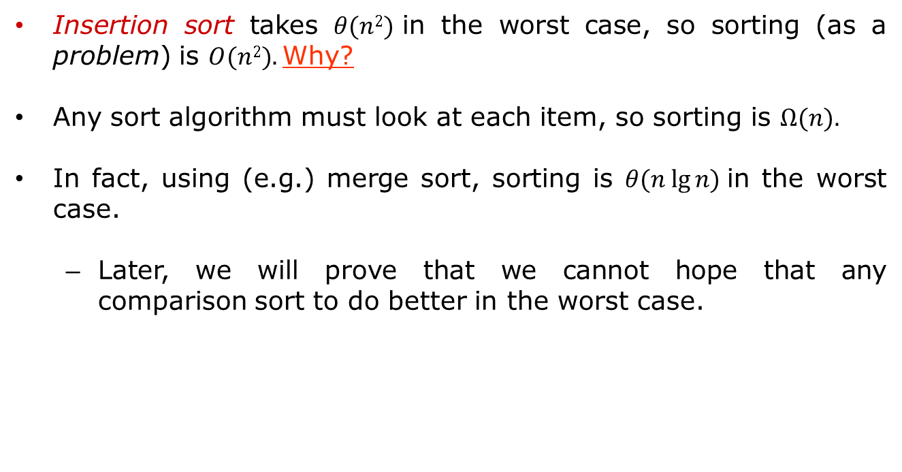
Lecture 1. Introduction (Asymptotic Notation, Algorithm Analysis)
Example
Insertion sort takes $θ(n2)$in the worst case, so sorting (as a problem) is $O(n2).$Why?
Any sort algorithm must look at each item, so sorting is $Ω(n).$
In fact, using (e.g.) merge sort, sorting is $θ(n lg⁡n)$in the worst case.
Later, we will prove that we cannot hope that any comparison sort to do better in the worst case.

Slide 16
Lecture 1. Introduction (Asymptotic Notation, Algorithm Analysis)
Algorithmic Analysis
A technique used to characterize the execution behavior of algorithms in a manner independent of a particular platform, compiler, or language.
Abstract away the minor variations and describe the performance of algorithms in a more theoretical, processor independent fashion.
A method to compare speed of algorithms against one another.

Slide 17

Lecture 1. Introduction (Asymptotic Notation, Algorithm Analysis)
Monotonicity
$f(n)$is
monotonically increasing if $m≤n  f(m)  f(n)$
monotonically decreasing if $m≤ n  f(m)  f(n)$
strictly increasing if $m < n  f(m) < f(n)$
strictly decreasing if $m > n  f(m) > f(n)$

Slide 18
Lecture 1. Introduction (Asymptotic Notation, Algorithm Analysis)
Exponentials
Useful Identities:
Exponentials and polynomials

Slide 19

Lecture 1. Introduction (Asymptotic Notation, Algorithm Analysis)
Logarithms
$x = logba$is the
exponent for a = b^{x}.
Natural $log$: $lga = logea$
Binary$log$: $lg⁡a = log2a$
$$lg2a = (lg⁡a)2$$
$$lg⁡lg⁡a = lg⁡(lg⁡a)$$

Slide 20

Lecture 1. Introduction (Asymptotic Notation, Algorithm Analysis)
Logarithms and exponentials – Bases
If the base of a logarithm is changed from one constant to another, the value is altered by a constant factor
Ex: $log10 n ∗ log210 = log2 n$
Base of logarithm is not an issue in asymptotic notation
Exponentials with different bases differ by a exponential factor (not a constant factor)
Ex: $2n = (2/3)n∗3n$

Slide 21

Lecture 1. Introduction (Asymptotic Notation, Algorithm Analysis)
Polylogarithms
for $a≥0, b>0, \lim_{n→∞}\left(\frac{\lg^{a}n}{n^{b}}\right)=0$,
so $\lg^{a}n=o\left(n^{b}\right),$ and $n^{b}=ω(\lg^{a}n)$
Prove using L’Hopital’s rule repeatedly
$\lg\left(n!\right)=θ(n\lg{n})$

Slide 22
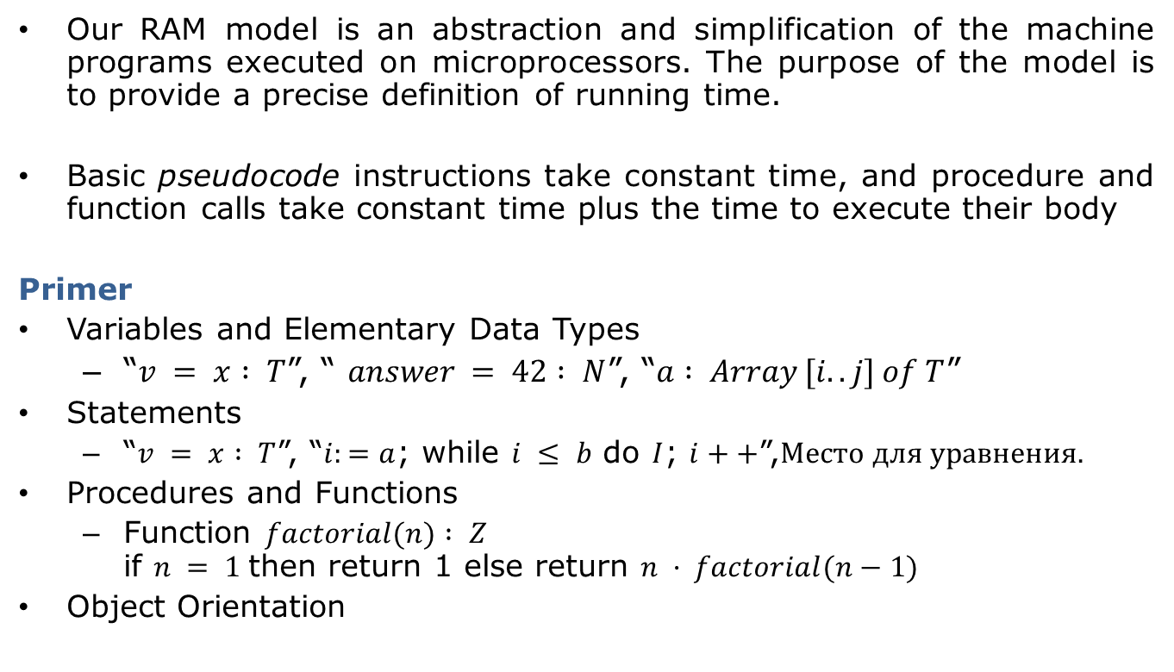
Lecture 1. Introduction (Asymptotic Notation, Algorithm Analysis)
Pseudocode
Our RAM model is an abstraction and simplification of the machine programs executed on microprocessors. The purpose of the model is to provide a precise definition of running time.
Basic pseudocode instructions take constant time, and procedure and function calls take constant time plus the time to execute their body
Primer
Variables and Elementary Data Types
“$v = x : T$”, “ $answer = 42 : N$”, “$a : Array [i.. j] of T$”
Statements
“$v = x : T$”, “$i:=a$; while $i ≤ b$ do $I$; $i++$”,
Procedures and Functions
Function $factorial(n) : Z$ if $n = 1$then return 1 else return $n · factorial(n−1)$
Object Orientation

Slide 23
Lecture 1. Introduction (Asymptotic Notation, Algorithm Analysis)
DESIGING ALGORITHMS
Designing correct algorithms and translating a correct algorithm into a correct program are nontrivial and error-prone tasks. In this section, we learn about assertions and invariants, two useful concepts for the design of correct algorithms and programs.

Slide 24
Lecture 1. Introduction (Asymptotic Notation, Algorithm Analysis)
Different Algorithms
Why are the words in a dictionary in alphabetical order?
A brute force approach
linear search
worst case is (d x N)
Another way
divide and conquer
worst case is (c x log N)
Constants are unknown and largely irrelevant.

Slide 25
Lecture 1. Introduction (Asymptotic Notation, Algorithm Analysis)
Assertions and Invariants
Assertions and invariants describe properties of the program state, i.e., properties of single variables and relations between the values of several variables.
Precondition
Postcondition
Loop Invariants holds before and after each loop iteration
Data Structure Invariants complex programs encapsulate their state in objects

Slide 26
Lecture 1. Introduction (Asymptotic Notation, Algorithm Analysis)
Bibliography
1. Sedgewick, Robert, and Philippe Flajolet. An introduction to the analysis of algorithms. Addison-Wesley, 2013.
2. Miller, Russ, and Laurence Boxer. "Algorithms Sequential And Parallel: A Unified Approach (Charles River Media Computer Engineering (Hardcover)), Charles River Media." Inc., Rockland, MA (2005).
3. Hopcroft, John E., and Jeffrey David Ullman. Data structures and algorithms. Vol. 175. Boston, MA, USA:: Addison-Wesley, 1983.
4. Knuth, Donald E. Selected papers on analysis of algorithms. CSLI Publications, 2000.
3. Bhargava, Aditya. "Grokking algorithms." (2016).

